Slide 1

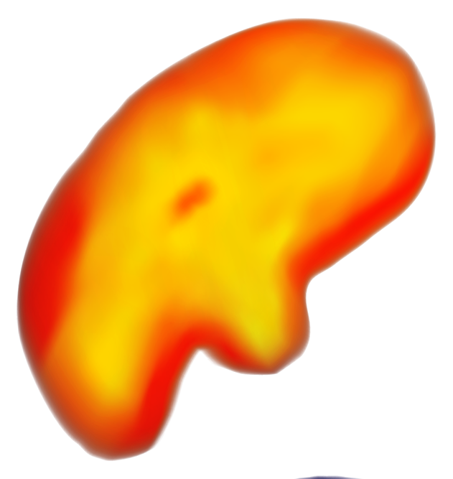
Cyclonic Cartography
Mapping Significant Tornadoes

Slide 2
Team
Amanda Pigman
Angie Foust
Barb Rupps
Cassidy Simmons
Scott Arterbury

Slide 3
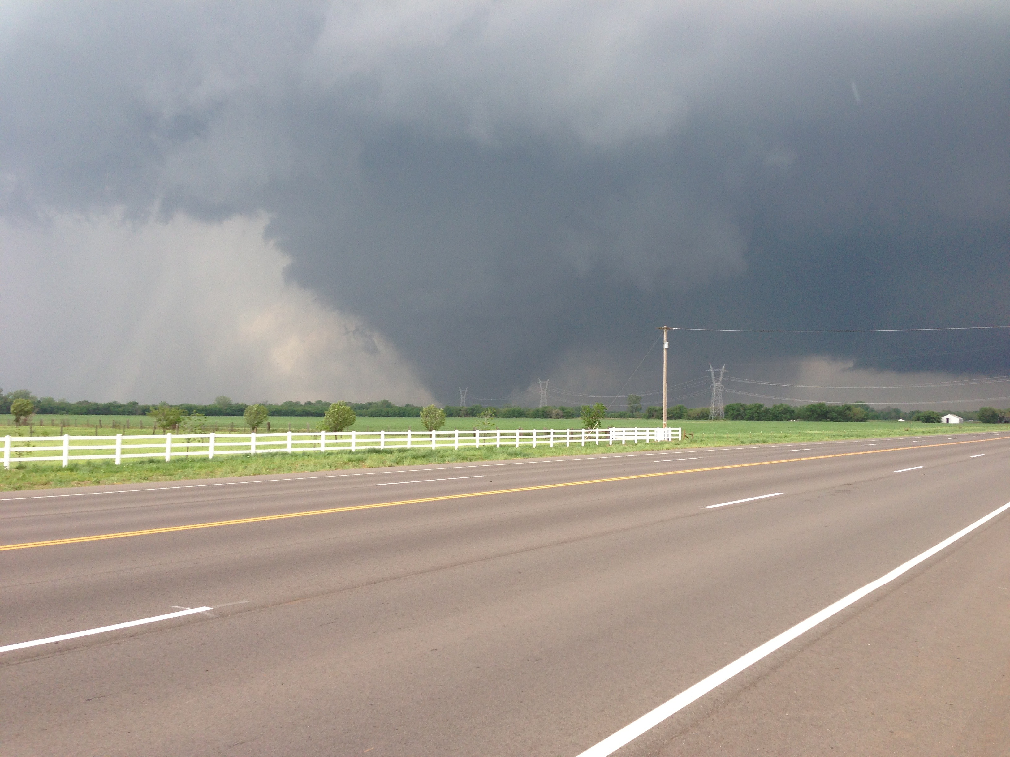
May 13, 2013 — Moore, Oklahoma

Slide 4
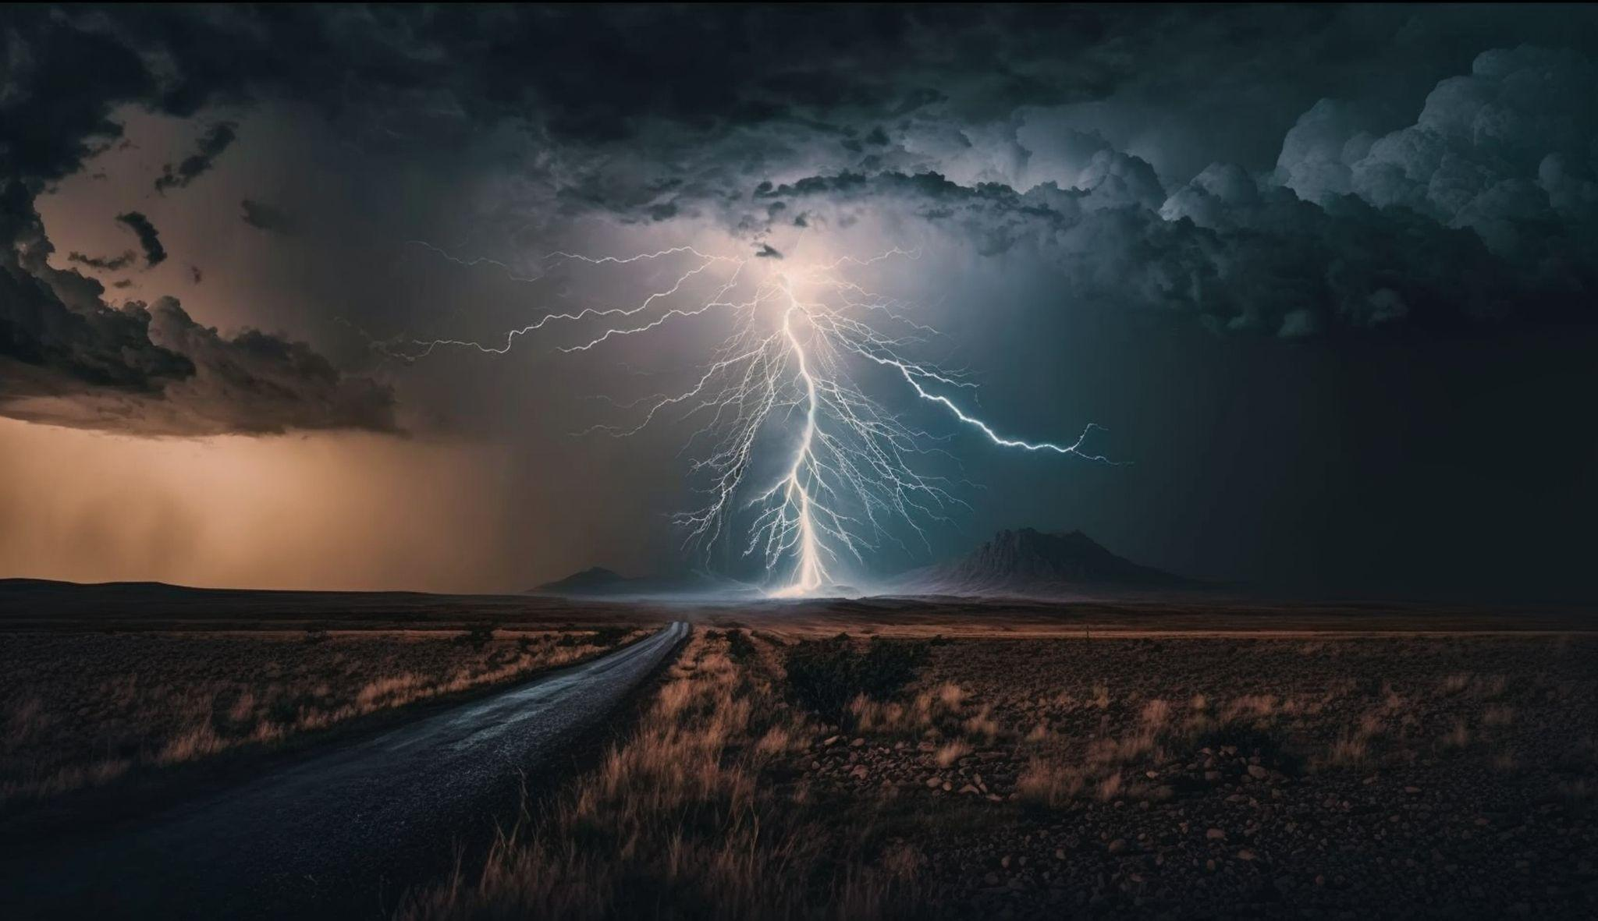
Is Tornado Alley Shifting?
Living in Oklahoma, we are keenly aware of severe weather.
However, it seems like there are not as many tornadoes as there used to be in this area.
We wanted to see what the data said.
Notes:
If you’ve lived in Oklahoma long, you know that oftentimes, early spring and early fall are the seasons of severe weather.
Something we discussed when deciding what to cover for our project 3, was that it seems as though there are fewer tornadoes around here than there used to be. This conversation was sort of the beginning inspiration for our focus in this project and we decided to take a look at the data to see what stories it might tell about tornadoes in the United States.

Slide 5
Methodology
Source
Our Scope
NOAA’s National Weather Service
(https://www.ncdc.noaa.gov/stormevents/) was our source.
Our considerations when choosing data:
All tornadoes?
As far back as there are records?
Significant tornadoes?
Limit to more recent years?
Has tornado alley shifted?
Notes:
The considerations we made while choosing what kind of data to explore include : (touch on ‘our scope’ items).

Slide 6
Extract, Transform, and Load
Data Sourcing
Data Cleaning
Data Loading
Using the National Weather Service’s data, we filtered all weather events to tornadoes. We determined to focus on the data starting January 1, 2000 and EF 3 and stronger tornadoes.
We cleaned the data by removing columns of information that we didn’t need for our analysis and combining multiple CSV files (due to limitations from the website) into one file.
We removed rows with missing data.
We converted our CSV files to both regular JSON and geoJSON files to use in our visualizations.
We also created a MongoDB to parse the data for our charts.
Notes:
We were able to obtain all data from NOAA’s National Weather Service. After exploring the available data and seeing the vast amount of data available, we decided to limit it to tornadoes of magnitude EF3 and higher from the years 2000 - 2023.
The website limited the amount of data we could download in one file to 500 rows, so we started with three separate CSV files. As a team, we determined that there were a number of columns we could remove. I used Excel to combine the files and remove the unnecessary columns.
I used online file converters to convert the cleaned CSV file into JSON and geoJSON formats to use for our visualizations. Angie was able to create and import our file into MongoDBto parse the data for her charts.

Slide 7
Ethical Considerations
Exploratory Only
No Personal Information
Our project was only exploratory in nature and not intended to influence policy or decision making of any kind.
Our data did not include any personal identifiable information
Notes:
As far as ethical considerations - there was no personal information involved with the data in this project. The data is part of the public domain and we are able to use freely as long as we do not:
Claim it as our own
Use it in a way that implies we are affiliated with, or endorsed by, NOAA
Modify content and then present as official government material.
Our project was only exploratory in nature and not intended to influence policy or decision making of any kind.

Slide 8

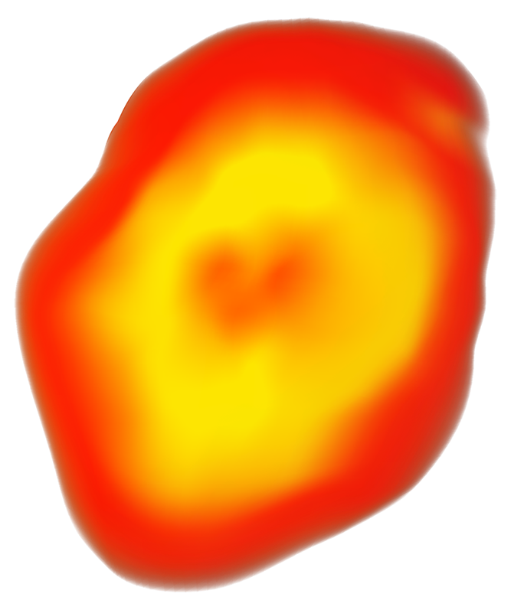
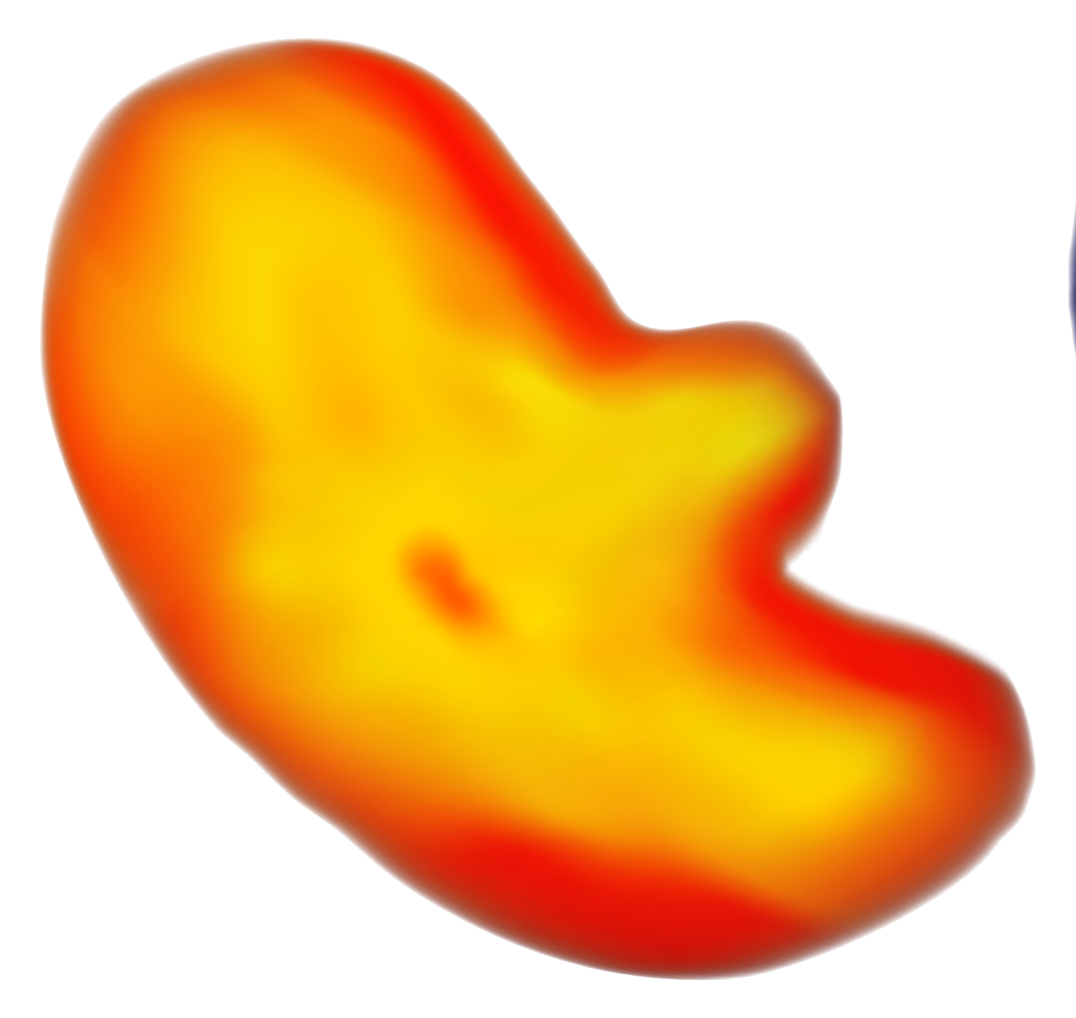
Let’s Look at the Data

Slide 9
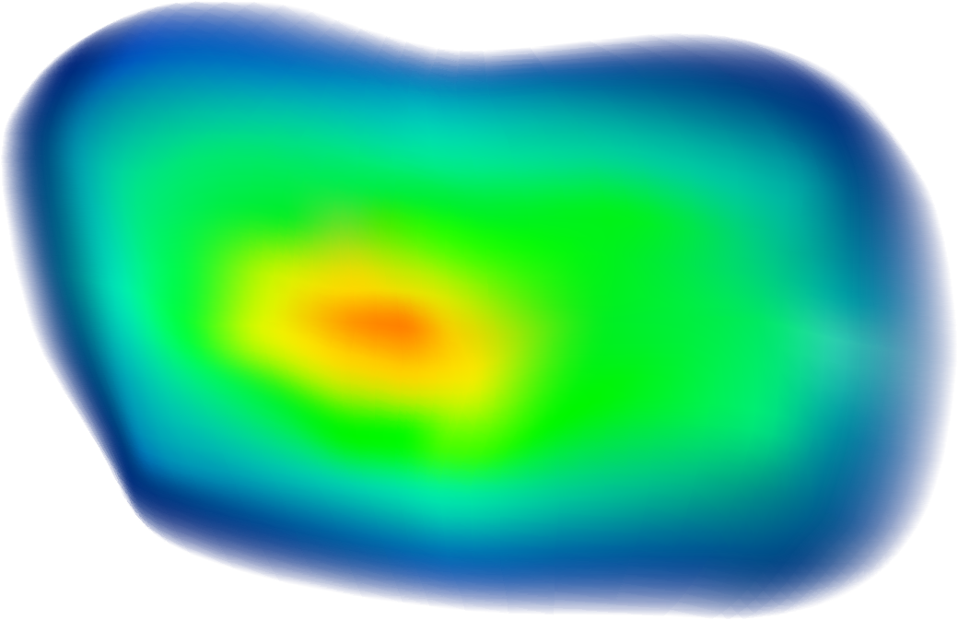
THANKS!
Do you have any questions?
youremail@freepik.com
+34 654 321 432
yourwebsite.com
Please keep this slide for attribution

